Slide 1
Toolwear Classification
Prof. Kundan Kumar Singh, Aryan Pola

Slide 2
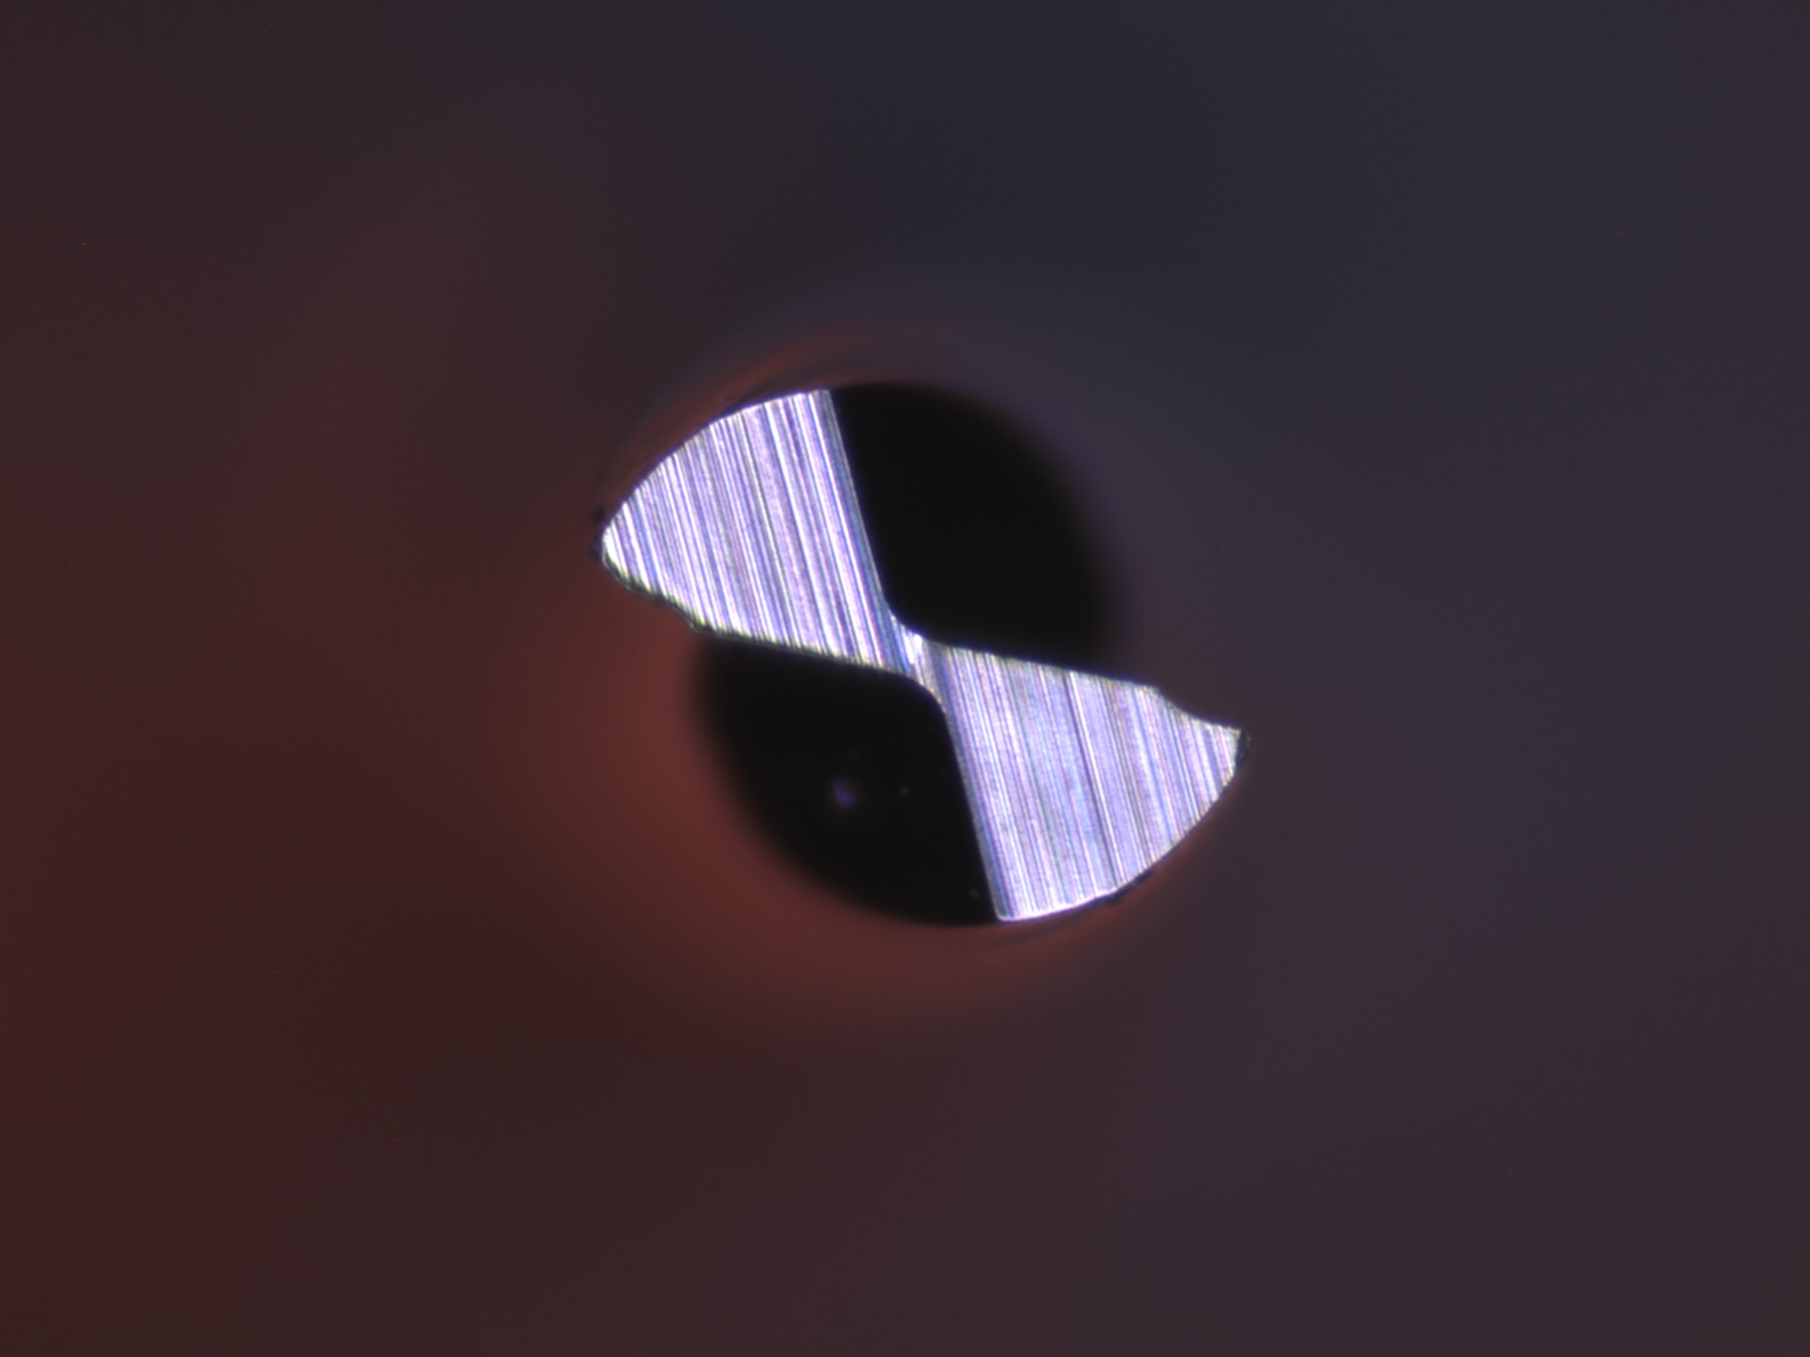
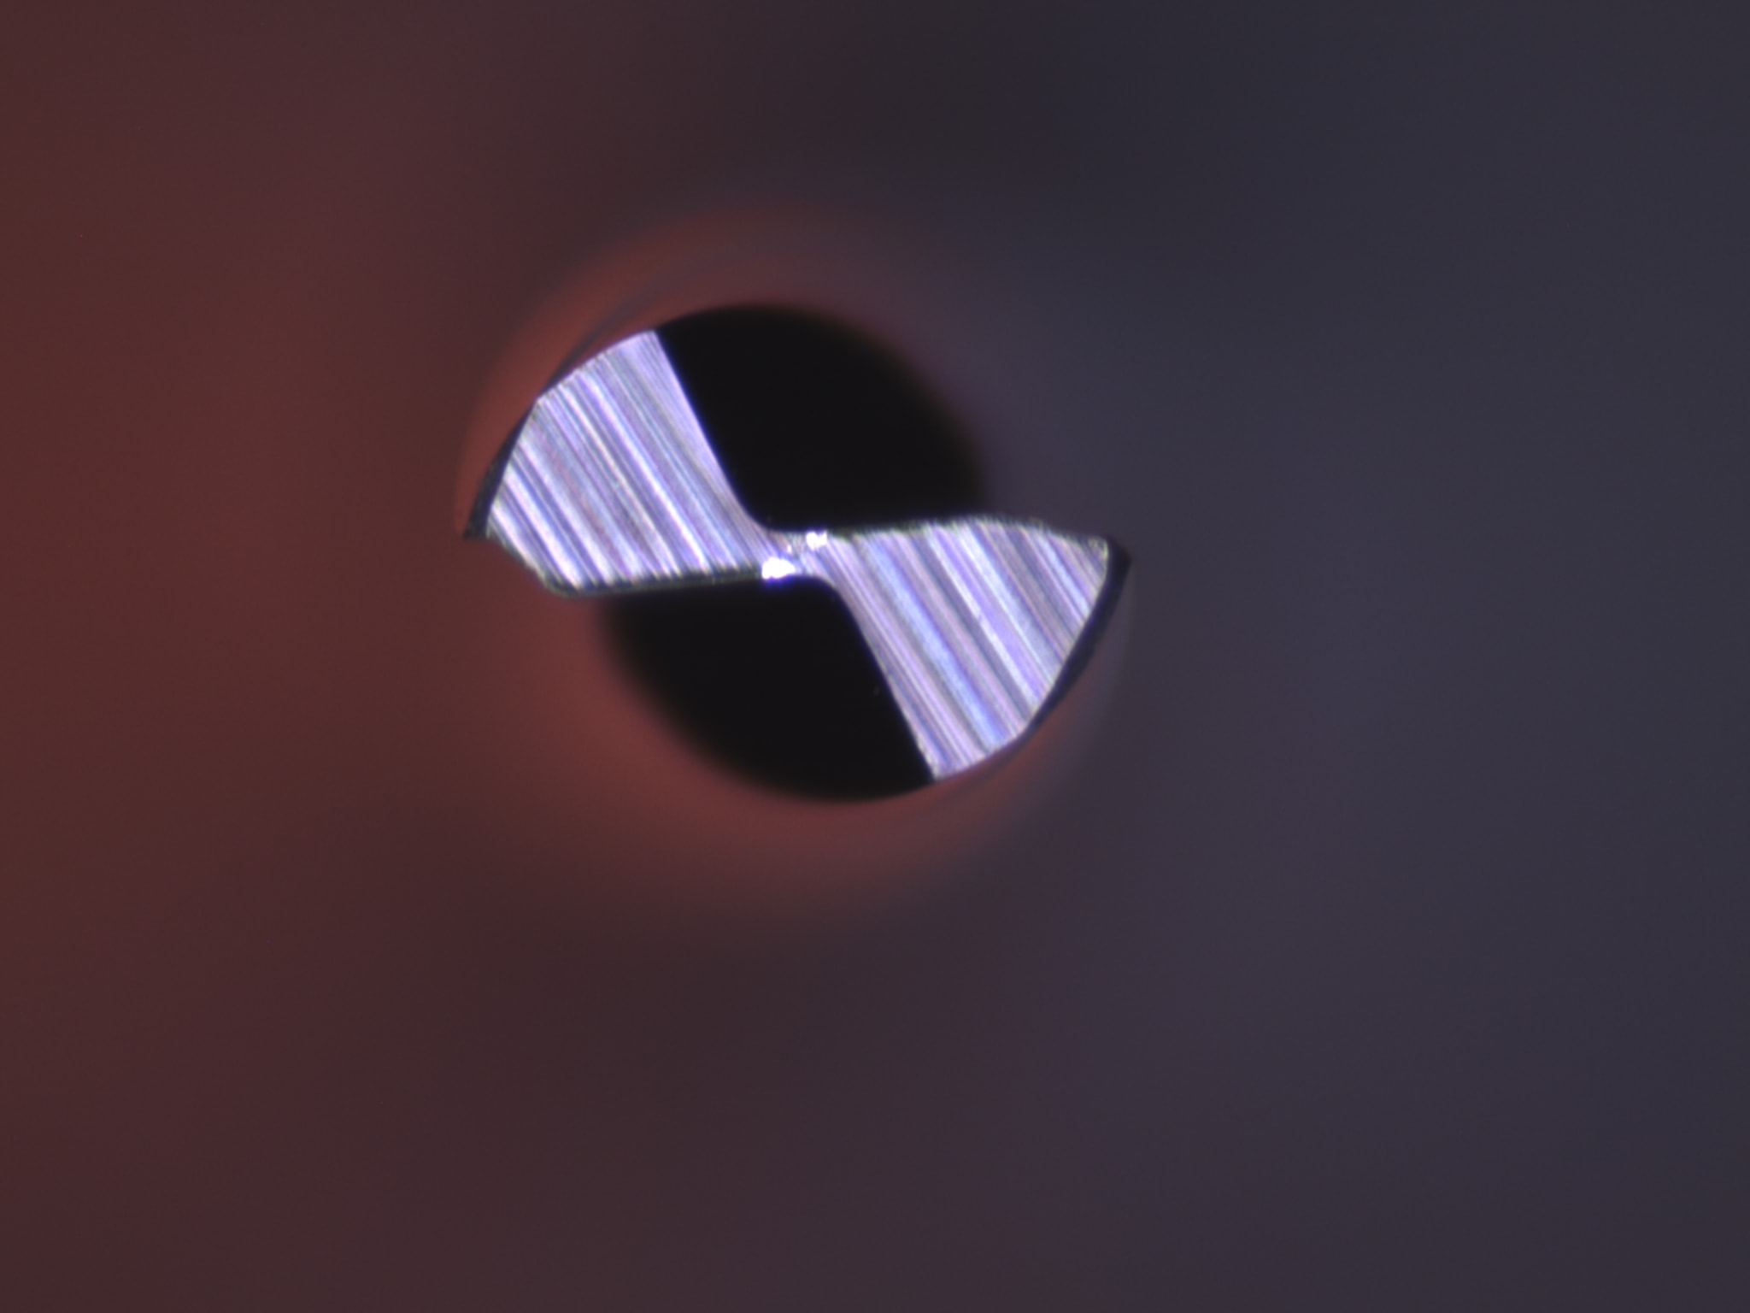
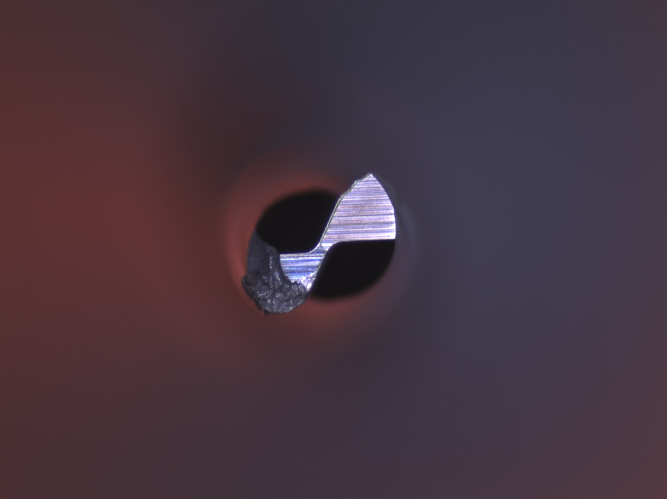
Introduction and Motivation
Challenge: We only have 32 original images(categorized into fine, mild, severe), which are insufficient for training a deep CNN.
Our Approach to solution: Augment the limited data using flips, rotations and generate synthetic data to produce realistic new images for further data volume boost. Natural augmentation and Deep Convolutional GAN (DCGAN) enables successful training of CNN by providing data.

Slide 3
Data Collection and Labelling
Original Dataset: 32 high resolution images (2048*1536) of worn cutting tools. Each image is labelled into one of the 3 classes i.e. fine, mild, severe using the mean diameter attribute from the excel sheet.
Diameter <= 10 -> fine
Diameter > 10 and Diameter <= 15 -> mild
Diameter > 15 -> severe
Train/Test Split: The images were split ~75/25% per class (e.g. ~24 train, 8 test). This yields an initial training set of only ~24 images (across 3 classes) – far too few for deep learning. Hence, augmentation is crucial.

Slide 4
Data Augmentation Pipeline
Goal: Inflate the dataset size by creating many altered copies of each original image. We aimed for ~300 images per class (combining train+test) after augmentation.
Techniques Applied:
1. Geometric: Rotate images by various angles (e.g. ±5°, 10°, 15°, 20°) and horizontal flip.
2. Noise: Add Gaussian noise at multiple levels (σ = 10, 15, 20, 25).
3. Photometric: Adjust brightness and contrast (e.g. ±20% variations)​

Slide 5
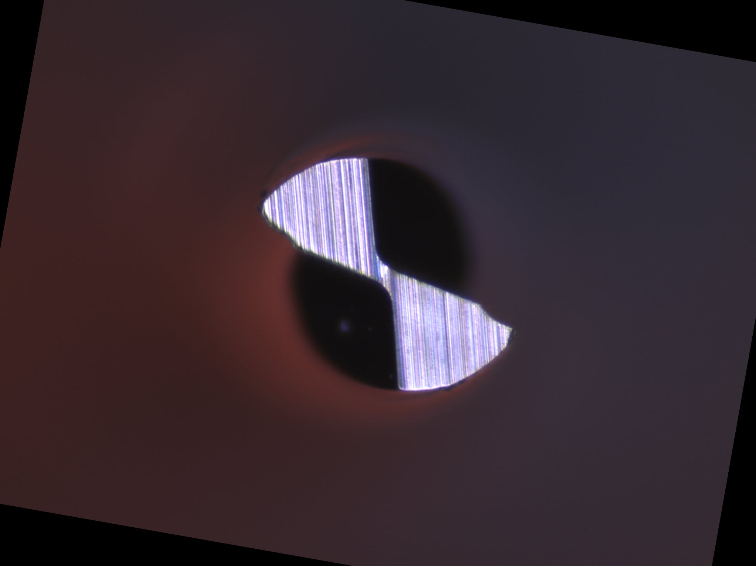
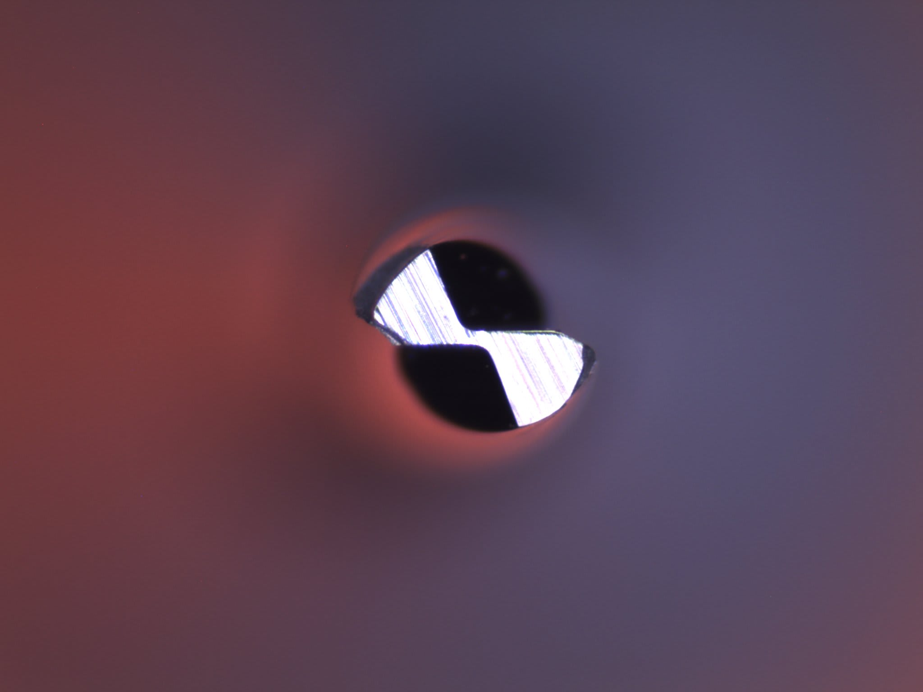
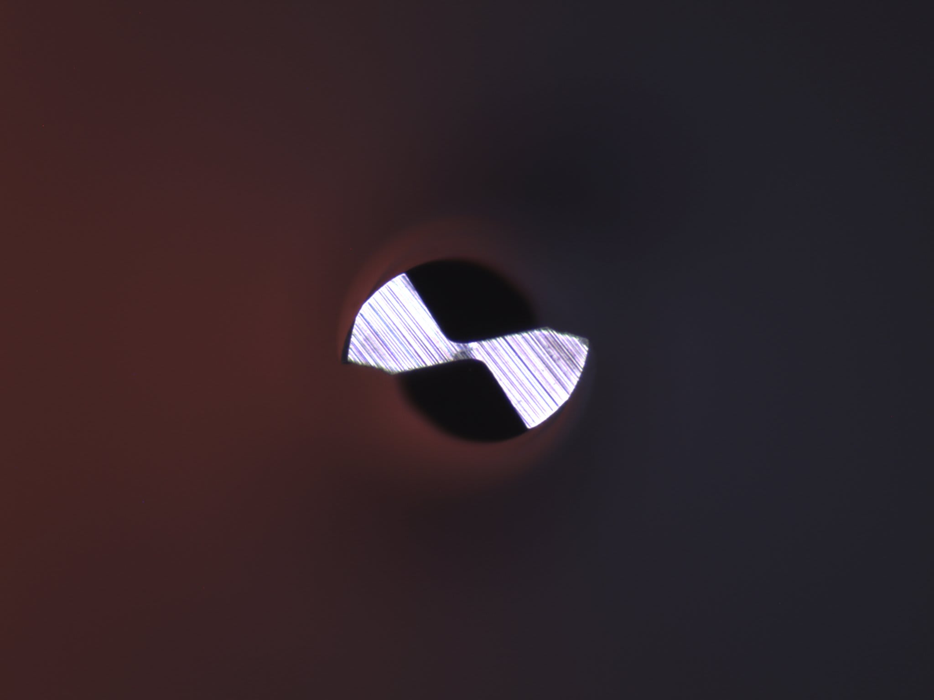
Augmentation Process: Each original image is fed into a function augment_image_controlled which applies these transformations and generates many variants. We generated up to ~40 augments per image (rotations, one flip, several noise and brightness/contrast adjustments) until reaching a target count. Augmented images were saved in new subfolders (e.g. fine_train_augmented).
Resulting Dataset: 240 augmented training images per class (including the original images copied in) and 60 augmented test images per class. This expanded the dataset roughly tenfold (from 32 to 900 images total) using just natural augmentation.

Slide 6
Synthetic Data Generation with DCGAN
Objective: Employ a Deep Convolutional GAN (DCGAN) to synthesize novel tool‑wear images, thereby extending the representational capacity of the dataset beyond standard augmentation techniques.
Generator Design
  Input: 100‑dimensional latent vector z∼N(0,1)
  Architecture: Series of Convolutional layers with kernel size 5 and stride 2, interleaved with Batch Normalization and ReLU activations to promote stable gradient propagation.
    Resolution Progression: Feature maps are upsampled through the sequence
    16×16 → 32×32 → 64×64 → 128×128 → 256×256 → 512×512 → 1024×1024
    Output Layer: Applies a tanh⁡ activation to constrain pixel intensities to [−1,1] producing a final 1024×1024 RGB image.

Slide 7
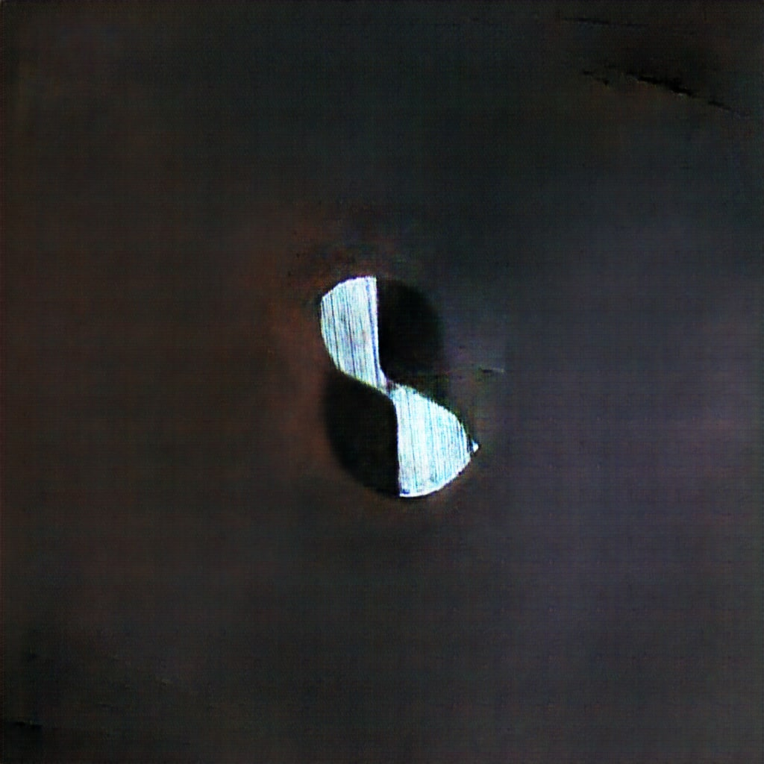
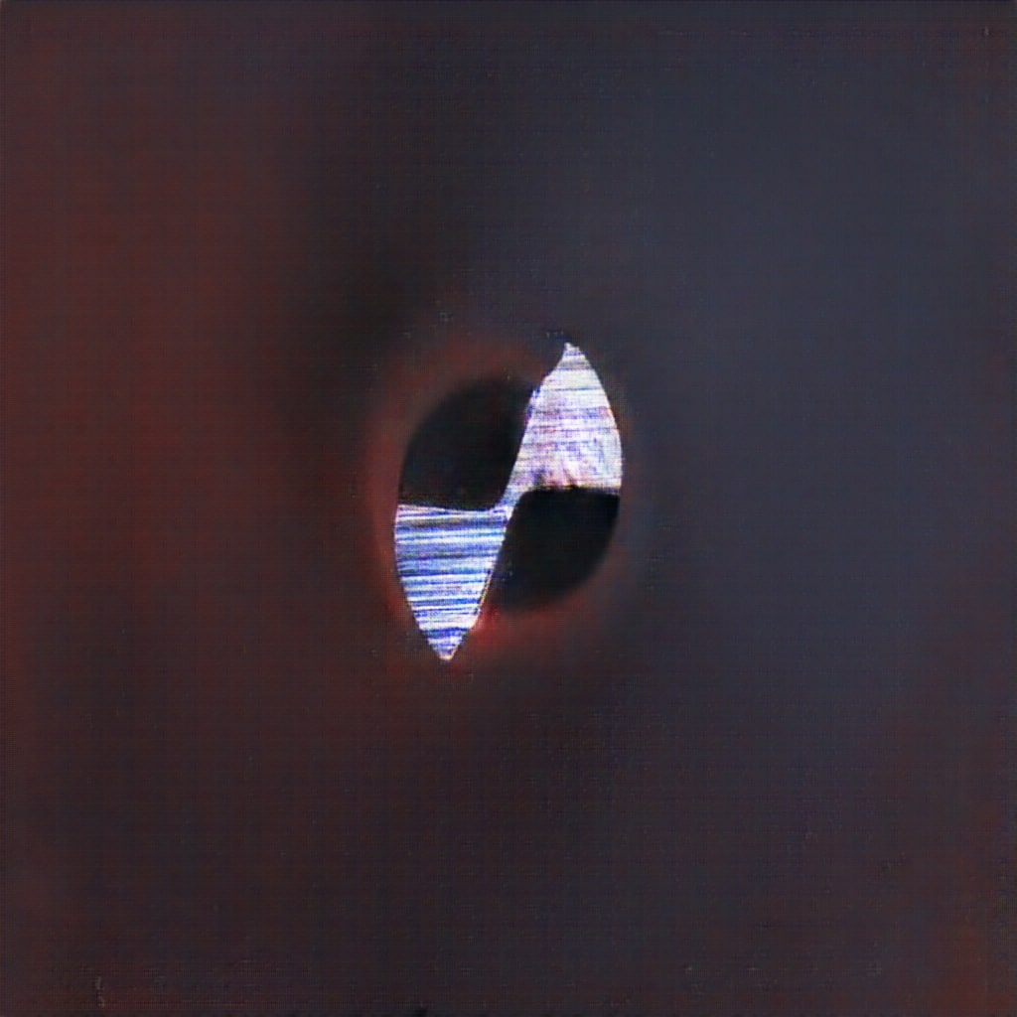
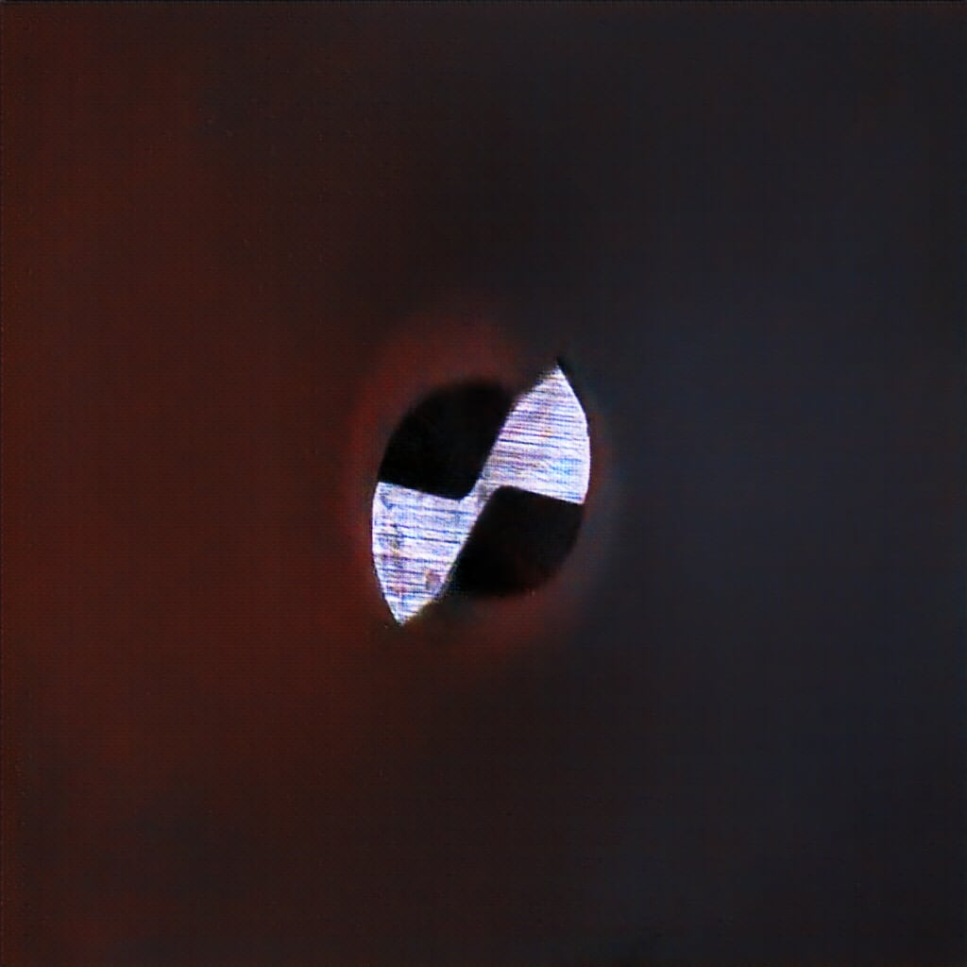
Discriminator Design:
  Input: 1024×1024 RGB image (real or generated).
  Architecture: Series of convolutional layers (Conv2D, kernel size 5, stride 2) to progressively downsample spatial dimensions
  1024×1024 → 512×512 → 256×256 → 128×128 → 64×64 → 32×32
  Regularization: LeakyReLU activations (negative slope 0.2) and Dropout layers to mitigate mode collapse and overfitting.
  Classification Head: Sigmoid activation on a flattened feature vector to yield a scalar probability of “realness.”

Slide 8
Final Dataset Composition
Combined Dataset: After augmentation and DCGAN synthesis, our dataset expanded from 32 to ~3,720 images (train + test). Each class now has roughly 1,240 training images (240 augmented real + ~1000 synthetic) and 60 test images.
Class Balance: The augmentation process was configured to produce equal numbers of images per class. Thus, the final training set is class-balanced (≈1240 images in each class). This removes any bias toward one wear category.

Slide 9
Model Architecture
Choice of Model: We selected GoogLeNet (Inception v1) as our CNN architecture. GoogLeNet is a 22-layer deep network that introduced Inception modules
Transfer Learning: We leveraged a pre-trained GoogLeNet (trained on ImageNet) to initialize our model. Rather than training from scratch (risky with limited data), we fine-tuned the network:
  Custom Classifier Head: Replaced the original 1000-class fully connected layer with a new sequence: Linear(in_features -> 256) -> LeakyReLU -> Dropout(0.5) -> Linear(256 -> 3) to output our 3 wear classes. We similarly updated GoogLeNet’s two auxiliary classifiers (aux1, aux2) to output 3 classes instead of 1000 (by replacing their final FC layers).
  Freezing Early Layers: We froze the very earliest layers (up to Inception module 1). Specifically, layers before “inception2” were kept at their pretrained weights, and only layers from “inception2” onward were set to trainable in our code​. This means the model retains low-level feature detectors (edges, textures) from ImageNet, and we only adjust higher-level feature layers to our tool wear data.

Slide 10
Input & Preprocessing: We feed the model 3-channel RGB images resized to 512×512. (GoogLeNet’s original input was 224×224, but we chose 512 for higher detail since our images are high-res. This comes at the cost of more VRAM usage.) We normalize inputs to the same mean/std as ImageNet. During training, we applied on-the-fly augmentations: random resized cropping to 512px, random horizontal flip, small rotations (±15°), and slight color jitter on brightness/contrast/saturation​. These augmentations (distinct from the offline augmentation) add further variability each epoch to prevent overfitting.

Slide 11
Model Training And Hyperparameters
Training Regime: We trained the model for up to 150 epochs, but with early stopping in place. We reserved 20% of the training data as a validation set (the first 80% of images were train, next 20% val, by index order). After each epoch, we evaluated on the validation set and on the test set to monitor performance.
Optimizer: Used AdamW optimizer (Adam with weight decay) for training. We set a base learning rate of 0.0001 for most layers. To be safe with the pretrained layers, we actually used a layer-specific LR schedule: very low LR (0.0001×0.01) for “inception2” layers, a low LR (0.0001×0.1) for “inception3” layers, and the base LR (1e-4) for later layers and the new FC layers​. This helps fine-tune gradually – earlier layers change the least, later layers change more.
Loss Function: Cross-entropy loss with label smoothing of 0.1. Label smoothing means when training, instead of using target labels as 100% one class, we use 90% for the true class and 10% distributed among others. This prevents the model from becoming over-confident and can improve generalization.
Regularization: Besides label smoothing and dropout, we used weight decay (0.01) in AdamW to penalize large weights. We also employed early stopping: if validation loss didn’t improve for 30 epochs, we halt training to avoid overfitting.
Learning Rate Schedule: Implemented ReduceLROnPlateau on validation loss – if val loss stagnated for 20 epochs, LR was reduced by a factor of 0.2​. This occurred a few times to refine the learning in later epochs. It ensured the model could settle into a minimum.

Slide 12
Batch Size & Gradient Accumulation: Batch size was 16 for 512×512 images (memory constraints). In code, we accumulate gradients over 4 mini-batches when batch_size<16 to simulate a larger batch, but since we used exactly 16, no accumulation was needed (accumulation_steps=1)​
Training Monitoring: We saved the model’s weights whenever the validation loss improved(keeping the best model). We also plotted training curves (loss and accuracy for train/val/test) every 10 epochs to visually inspect training progress.

Slide 13
Performance Evaluation on Test Set
After training, we evaluated the final model on the independent test set (which contains 60 images per class, none used in training). Key metrics on the test set:
  Accuracy: ~95% (percentage of all tool images correctly classified as fine/mild/severe).
  Macro F1-score: high (≈0.95), indicating strong balance – the model performs well across all classes. We use macro F1 since each class is equally important; it was virtually identical to micro F1 due to balanced classes.
  Precision & Recall: Each class’s precision and recall were in the 92–98% range. For instance, the model had near 100% recall on severe wear (caught almost all severely worn tools) and slightly lower on mild wear (a few mild cases were predicted as severe).
These results confirm that augmenting the data (both via traditional means and GANs) enabled the CNN to generalize well. The model can reliably distinguish between fine, mild, and severe tool wear on new images.
We also note that without the GAN-generated images, the model’s performance was weaker. In ablation tests (training with only augmented real images), accuracy dropped significantly. Thus, the synthetic data contributed critical additional variability that improved the classifier.

Slide 14
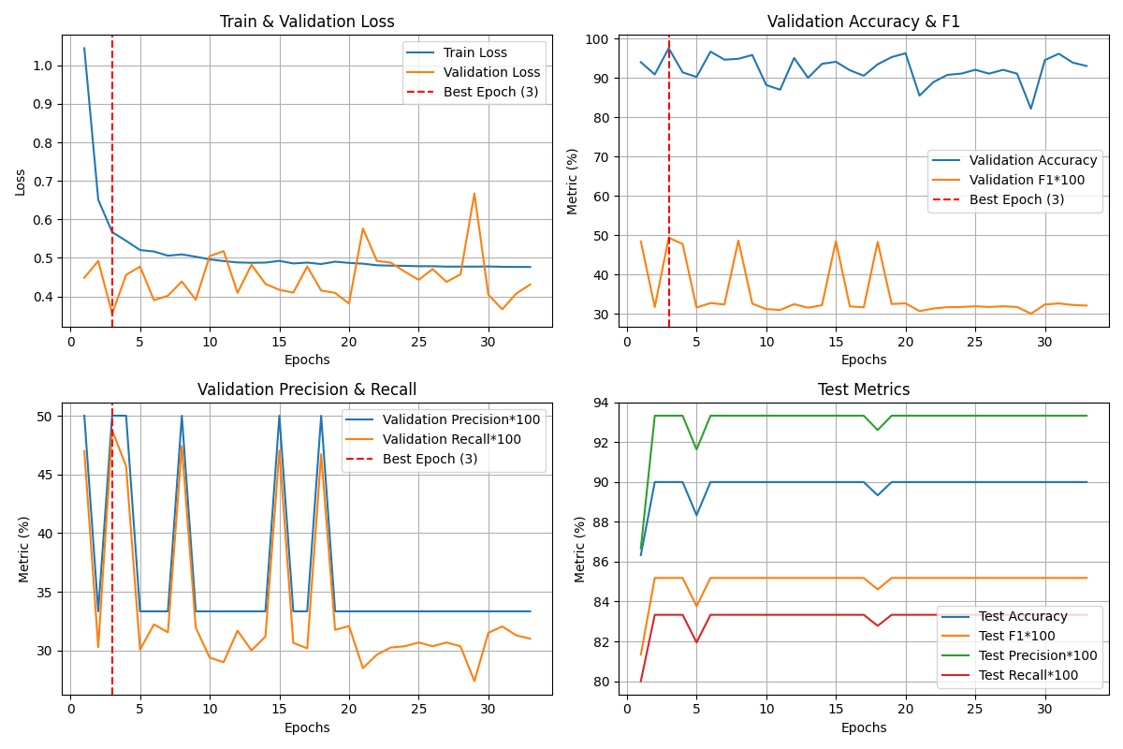

Slide 15
